Slide 1
FDR & The New Deal
http://www.youtube.com/watch?v=PXY7TkrPPzI&feature=player_embedded

Slide 2
Objective | Assessment
Students will understand the historical context surrounding the New Deal and its critics, especially the economic and social challenges facing the country during the Great Depression and analyze the conflicting viewpoints of the New Deal critics and assess the relative merits of their proposals. | Students will be asked to present in groups the information on their character that criticized the New Deal. They will be graded on written work, group work, and their individual contributions to the lesson.

Slide 3
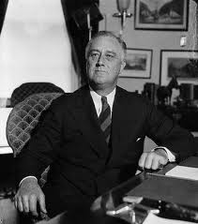
What were the goals of the New Deal?
What were the provisions of the New Deal programs?
What were the implications of the New Deal on the role of government in the lives of Americans?

Slide 4
Please get into your character groups of no more than six people and discuss the information that you found on your character.
Characters:
Huey Long
Father Charles Coughlin
Francis Townshend
Alf Landon
Franklin D. Roosevelt

Slide 5
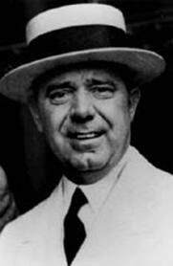
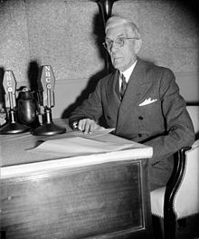
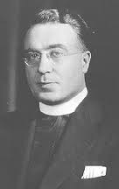
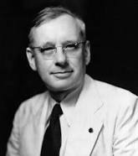
You will be given 10 minutes for your group to come up with a presentation that will explain who your character is, what the greatest problem facing the nation is, your character’s assessment of New Deal legislation, and your character’s recommendation to the President for action. The critics will present their cases to President Roosevelt’s group, the President’s group will defend his policies, and then the floor will be open for a freeform debate on the relative merits of New Deal legislation and any questions you may have.

Slide 6
Standards
American History II:
AH2.H.4
Analyze how conflict and compromise have shaped politics, economics and culture in the United States.
AH2.H.4.1
Analyze the political issues and conflicts that impacted the United States since Reconstruction and the compromises that resulted (e.g., Populism, Progressivism, working conditions and labor unrest, New Deal, Wilmington Race Riots, Eugenics, Civil Rights Movement, Anti-War protests, Watergate, etc.).
AH2.H.4.2
Analyze the economic issues and conflicts that impacted the United States since Reconstruction and the compromises that resulted (e.g., currency policy, industrialization, urbanization, laissez-faire, labor unrest, New Deal, Great Society, supply-side economics, etc.).
AH2.H.5
Understand how tensions between freedom, equality and power have shaped the political, economic and social development of the United States.
AH2.H.5.2
Explain how judicial, legislative and executive actions have affected the distribution of power between levels of government since Reconstruction (e.g., New Deal, Great Society, Civil Rights, etc.).

Slide 7
Standards Continued
Technology:
HS.SI.1
Evaluate resources needed to solve a given problem.
HS.SI.1.1
Evaluate resources for reliability. (Reliability can be determined by currency, credibility, authority, etc. depending on the curriculum topic).
HS.SI.1.2
Evaluate resources for point of view, bias, values, or intent of information.
HS.SI.1.3
Evaluate content for relevance to the assigned task.
HS.TT.1 Use technology and other
resources for assigned tasks.
HS.TT.1.1 Use appropriate technology tools and other resources to
access information (multi-database search engines, online
primary resources, virtual interviews with content experts).
HS.TT.1.2 Use appropriate technology tools and other resources to
organize information (e.g. online note-taking tools,
collaborative wikis).
HS.TT.1.3 Use appropriate technology tools and other resources to
design products to share information with others (e.g.
multimedia presentations, Web 2.0 tools, graphics,
podcasts, and audio files).

Slide 8
References
Retrieved on February 28, 2013 from http://www.youtube.com/watch?v=PXY7TkrPPzI&feature=player_embedded
The Great Depression. Retrieved on February 28, 2013 from http://www.besthistorysites.net/index.php/american-history/1900/great-depression
Retrieved on February 28, 2013 from www.dlt.ncssm.edu/.../lessonplans/.../New_Deal.../New_Deal_Critics

